Slide 1




Webinar
+
Sean Feldman – NServiceBus
Saravana Kumar – ServiceBus360

Slide 2
Understanding message flow in a large system

Slide 3
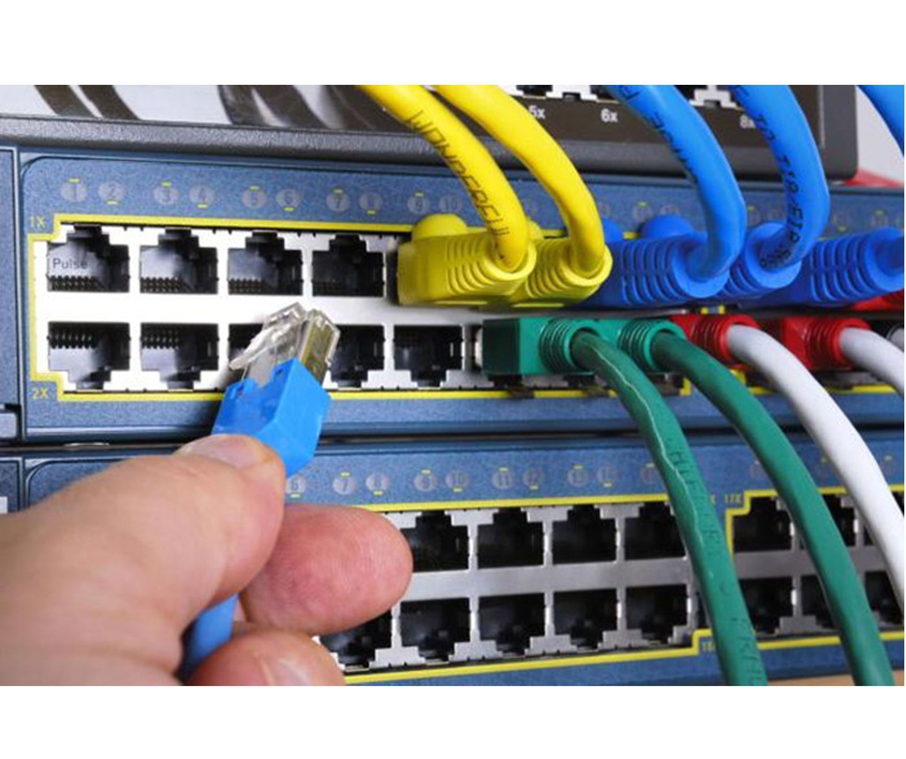
Easy when it’s small and simple

Slide 4
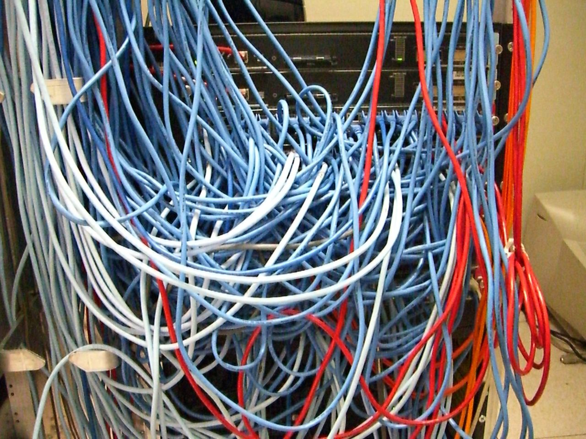
Everything’s under control

Slide 5
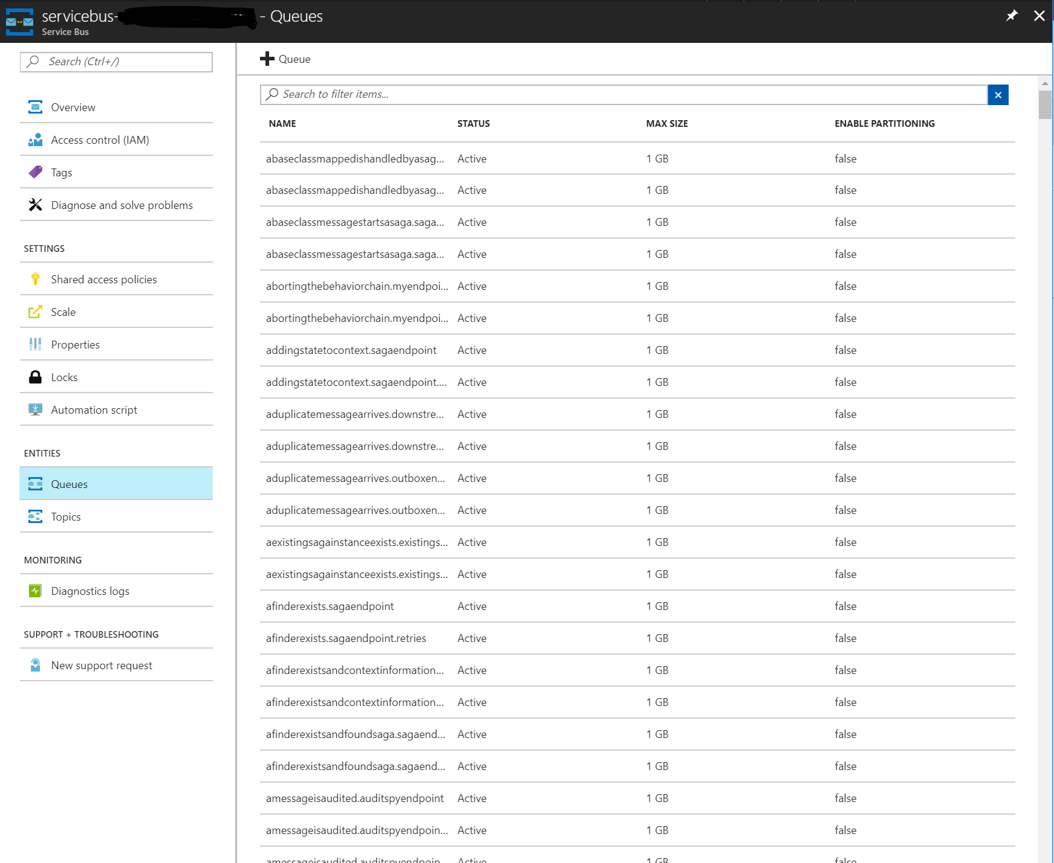
What’s what?

Slide 6
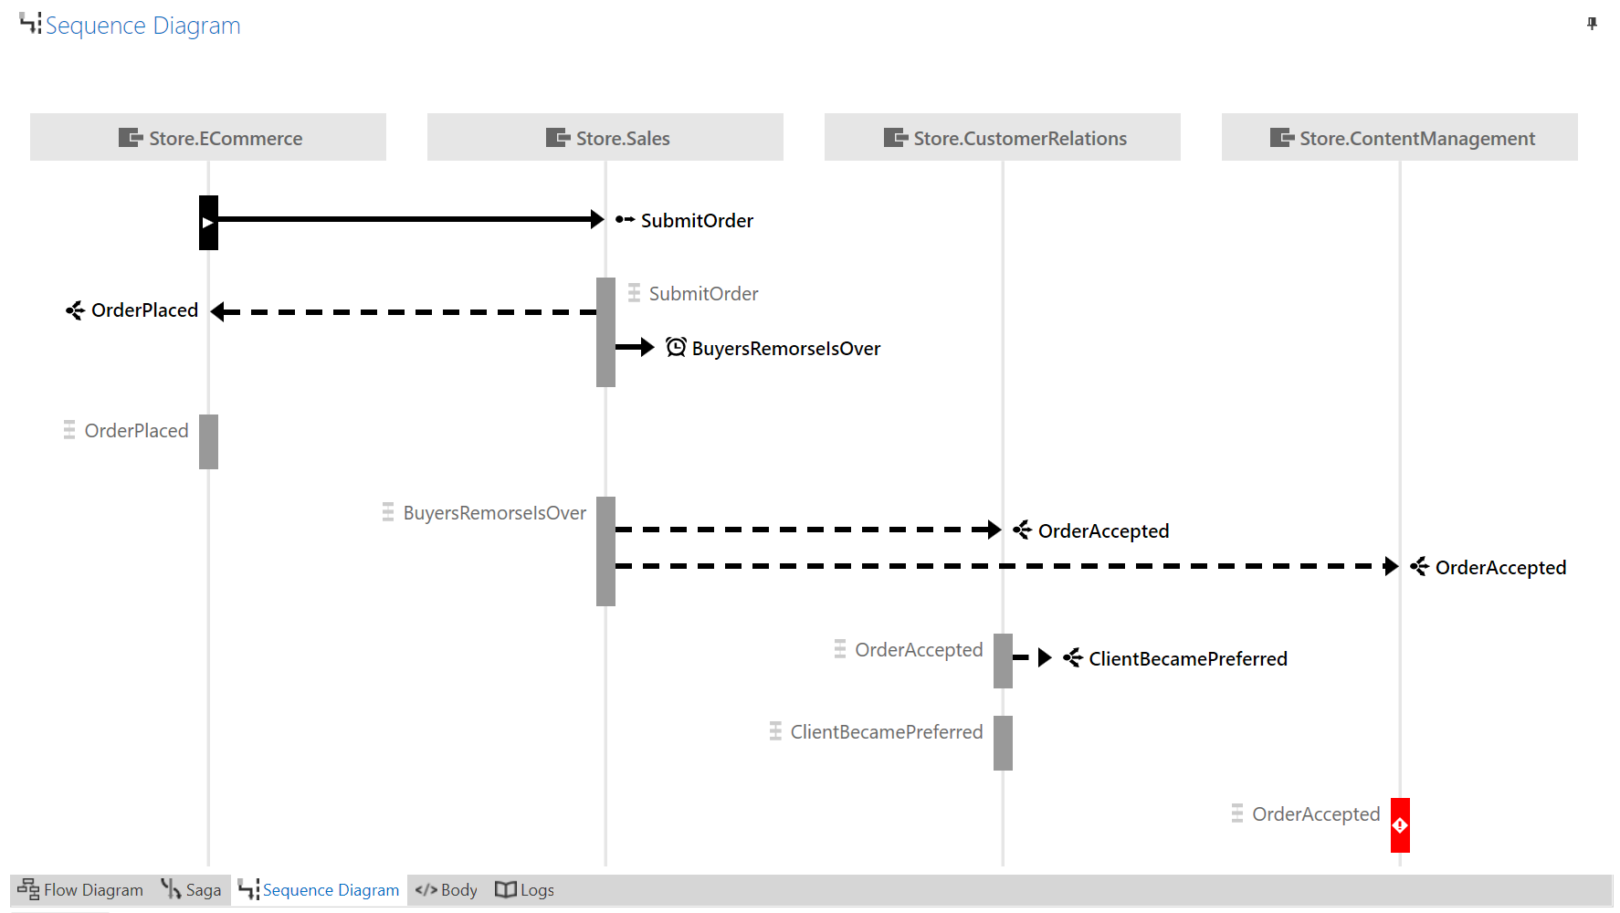
Message Flow with Particular Platform
Notes:
Message Flow with NServiceBus & Particular Platform

Slide 7
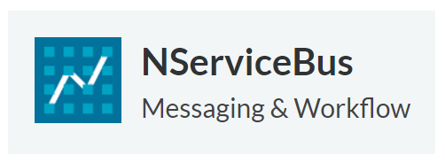
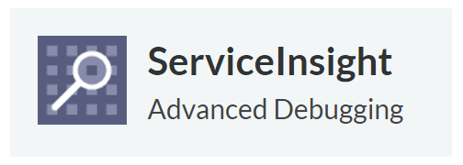
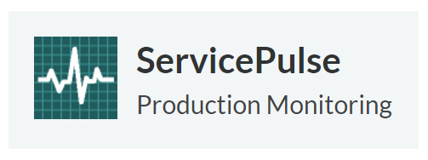
Particular Platform

Slide 8

What's NServiceBus?
Messaging and workflow code-based framework to build distributed systems that are
Simple, reliable, and scalable
Easy to work with and extend
Focus on domain problems and not the middleware

Slide 9




Why do I need NServiceBus?
Decoupling (RPC/WCF)
Asynchronous communication
Pub/Sub
Ability to breakdown monoliths into smaller components (services)
RPC/WCF

Slide 10

Message Types
Command
Known destination (unicast)
Instructs recipient to perform an action
Indicates sender knowledge of recipient
Event
Unknown destinations (multicast)
Immutable representation of something that occurred in the past
Command and Events are messages with Semantic Meaning. NServiceBus enforces the semantic of command and events.
Message

Slide 11




NServiceBus Concepts
Endpoint is a logical entity that communicates with other Endpoints
Endpoint instances physical deployment of endpoints and scale-out
Host environment where endpoints are running
Transport an abstraction of the underlying technology to provide messaging capabilities
Handler unit of code to operate on a message. Stateless.
Saga handles long running processes. Stateful. Usually represent workflows and coordinates work for handlers.

Slide 12

But What’s an Endpoint?
Shipping
Sales
A logical entity that communicates with other endpoints using messages
Usually equates to a process
Has a unique name
Contains message handlers
Deployed as a single or multiple instances
Customer
Relationship
Customer
Relationship
Customer
Relationship

Slide 13
Request/Reply Pattern
Endpoint A
Endpoint B

Slide 14
Demo: Pub/Sub Pattern
Subscriber A
Publisher
Subscriber B

Slide 15
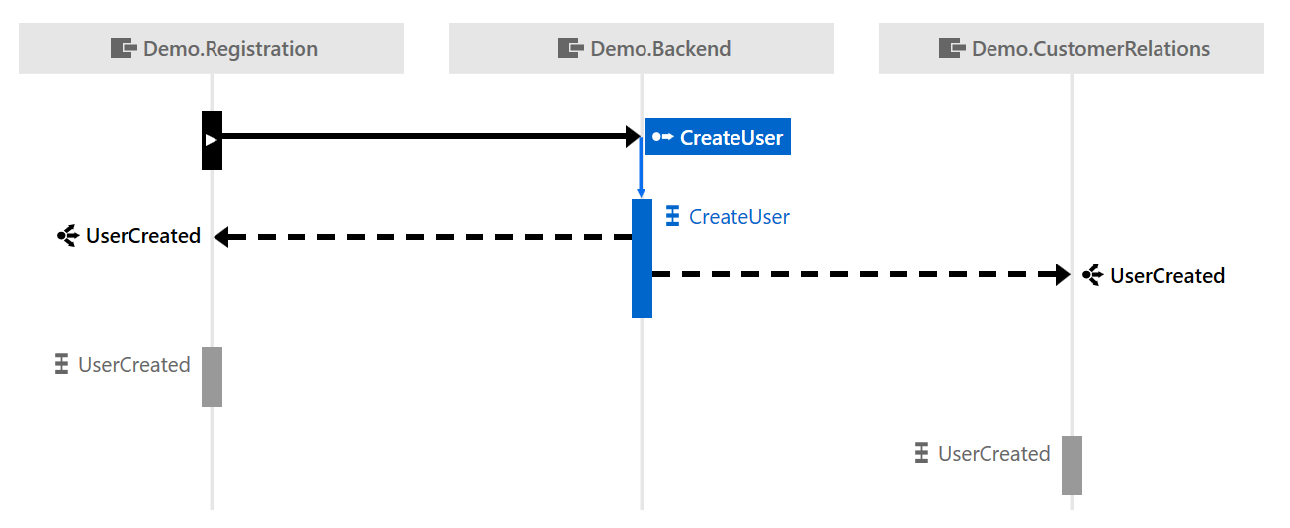
See Message Flow
Notes:
Screenshot is from Labs, not Insight

Slide 16
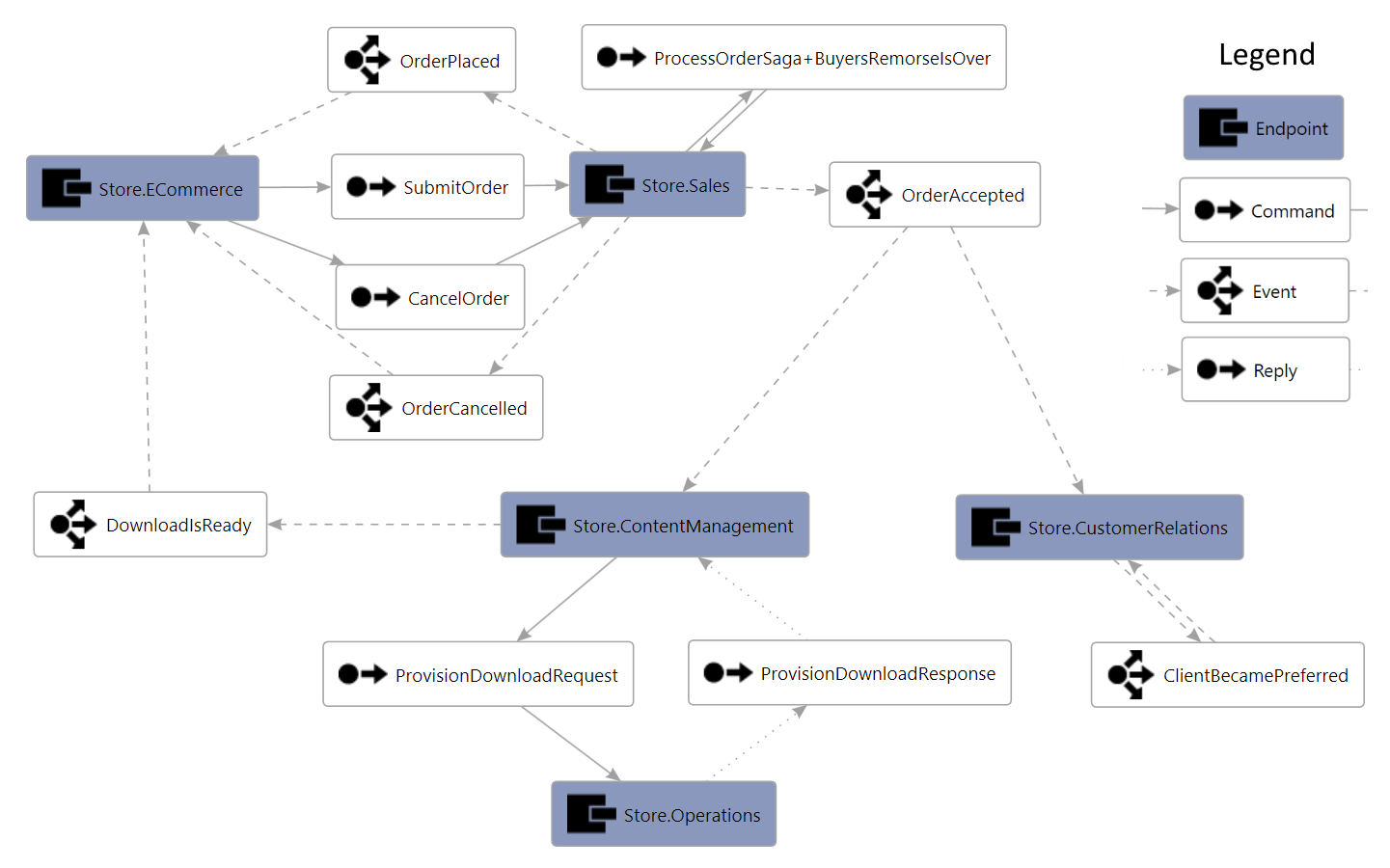
Routing Visualization
Notes:
https://github.com/ParticularLabs/RoutingVisualization

Slide 17
Resolving failure conditions

Slide 18
What are the errors and how to resolve those
What are the errors
How to resolve those

Slide 19
Messaging Over Raw ASB
Entities management
Maintaining connectivity
Factories and clients
Error handling
Transient or not
Retries and backoffs
Serialization
Receiving loop
Error handling
…
Sender
Receiver
Azure Service Bus namespace
Notes:
??? Might not belong here at all

Slide 20





NserviceBus Error Handling
Error queue
Recoverability
Immediate and Delayed
Connected to DeliveryCount
Unrecoverable exceptions
Custom Recoverability Policy
Notes:
Error queue vs dead-letter queue

Slide 21
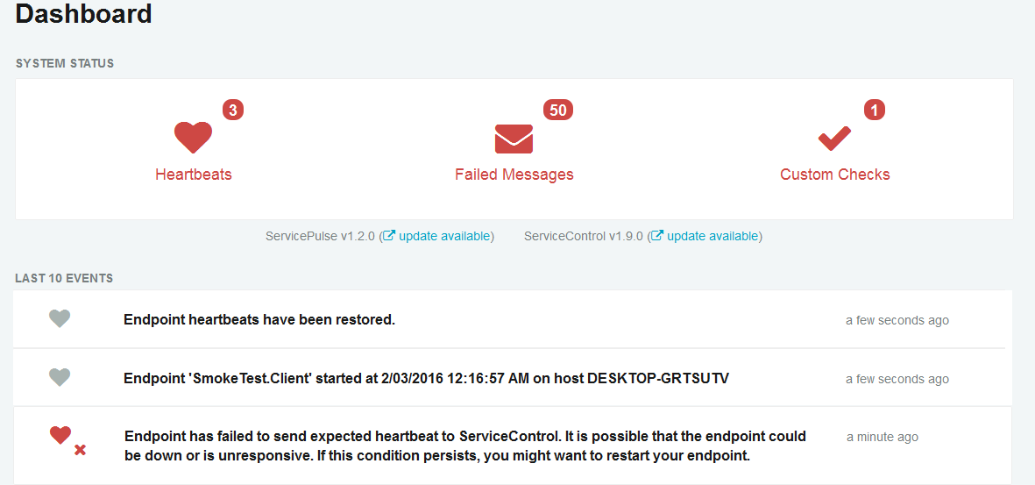
ServicePulse

Slide 22
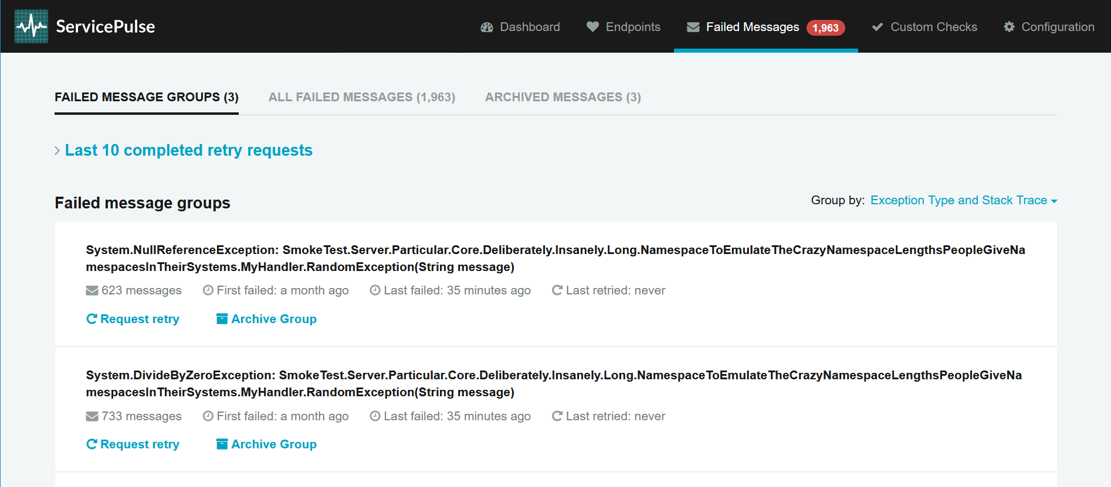
Service Pulse: Retrying failed messages
Notes:
Exception Type and Stack Trace - groups messages both by exception type and stack trace. It is the default way of categorizing failed messages.
Message Type - groups messages by message type.
Endpoint Address - groups messages by endpoint address where the failure occurred.

Slide 23
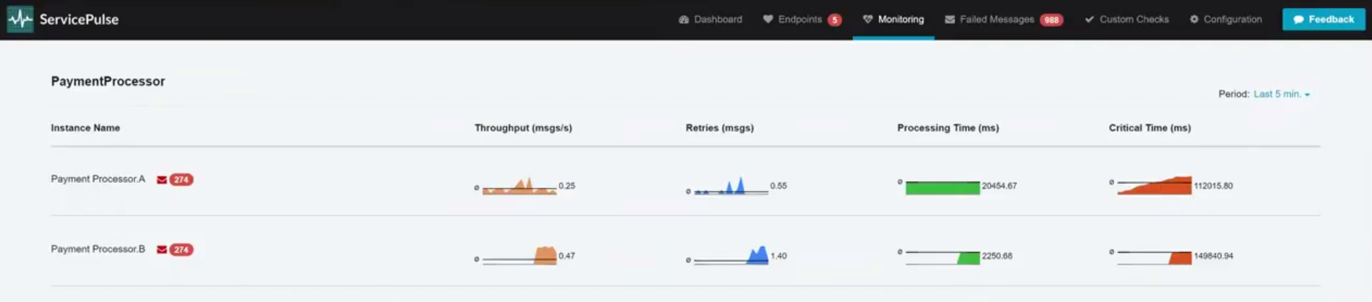
Scaled-out endpoints (preview)

Slide 24
Investigate Dead letter Messages and take appropriate actions like Message Resubmission or Purging

Slide 25
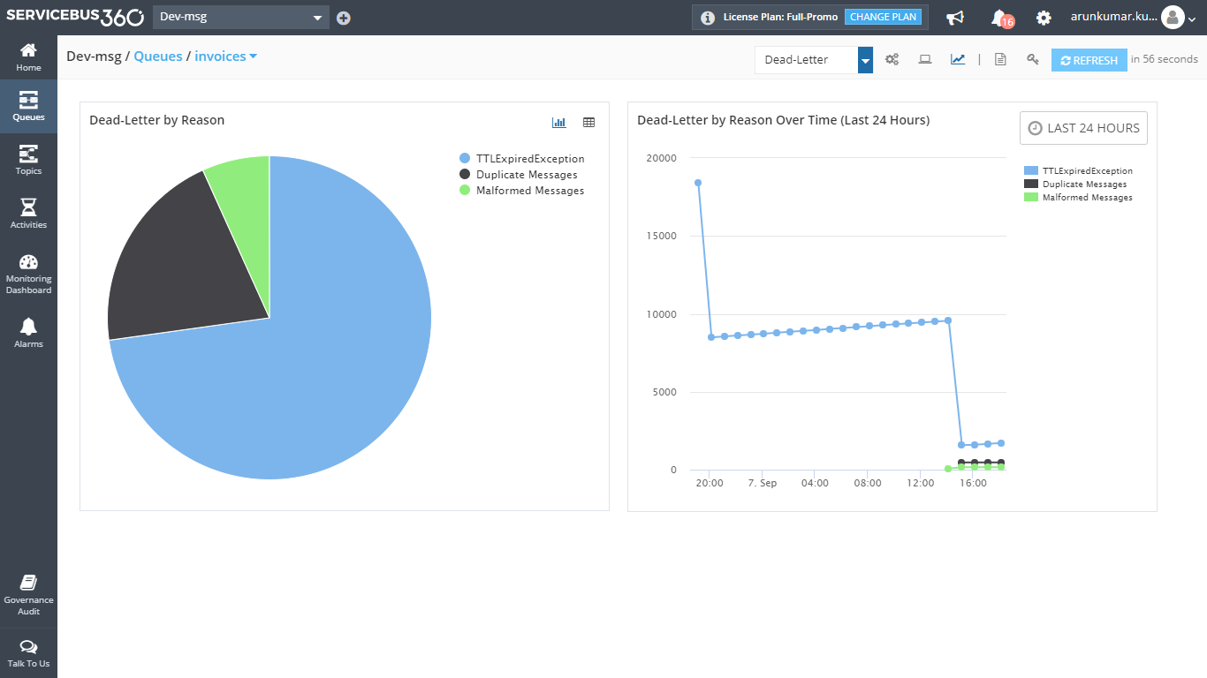
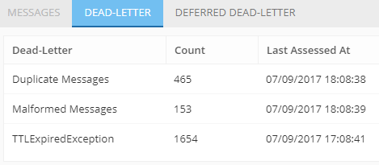
Investigate Dead letter Messages
How messages are Dead Lettered?
Why?
Messages get dead lettered due to various reasons
HeaderSizeExceeded
TTLExpiredException
MaxTransferHopCountExceeded
Specified by application
Session id is null

Slide 26
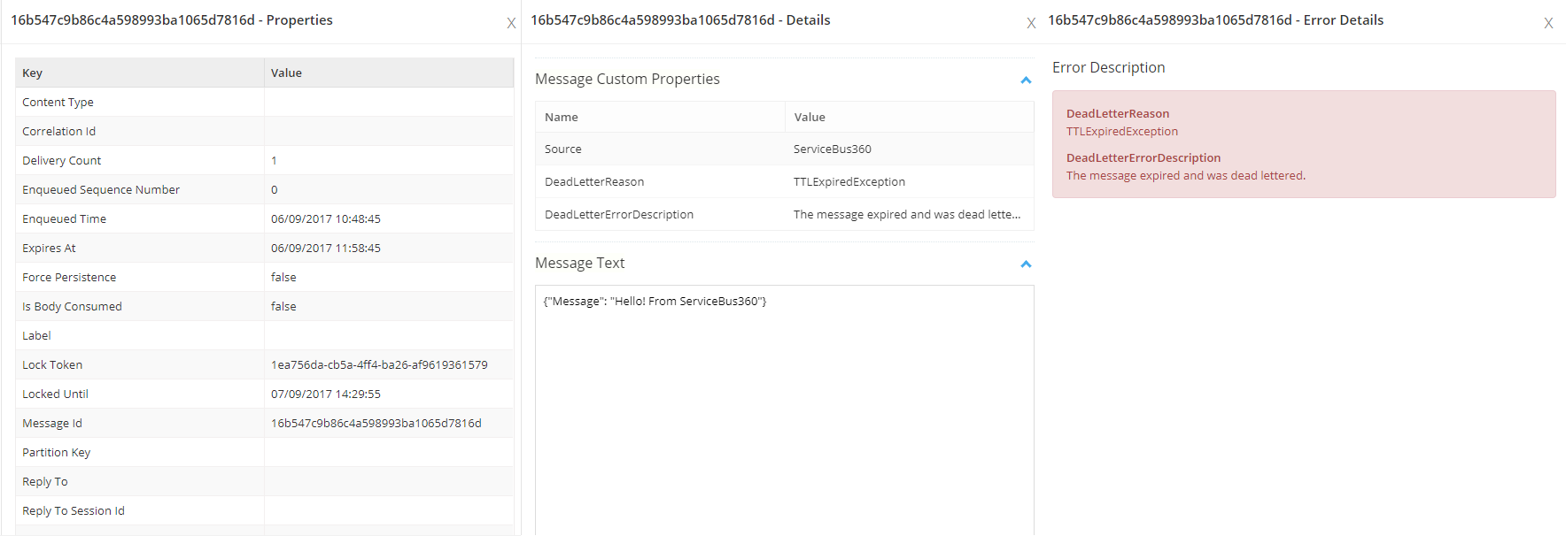
Investigate Dead letter Messages
Can I see what is in the message content?
Take a look at Message Properties
Why this message is dead lettered?

Slide 27
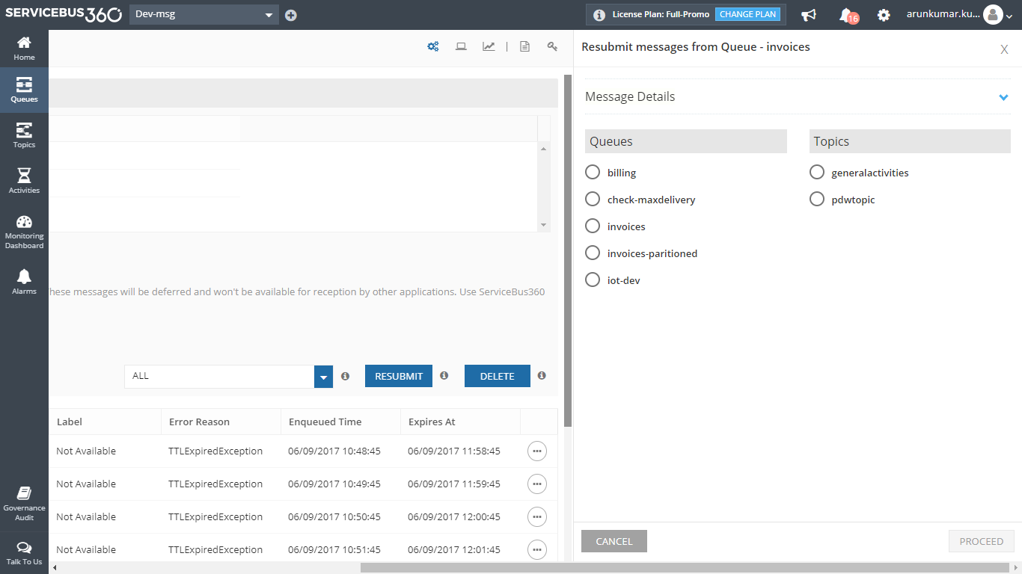
Resubmit or Delete Dead Letter Messages
Decide to resubmit or delete the message from the DLQ
I want to resubmit to a Queue / Topic

Slide 28
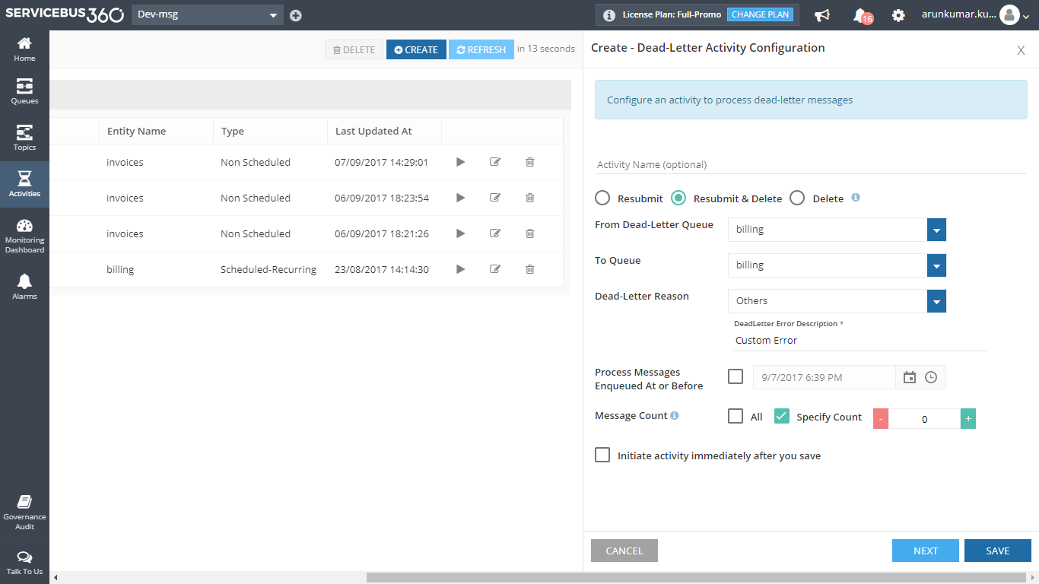
Resubmit or Delete Dead Letter Messages
Can I automate this process?
I want to resubmit all messages dead lettered due to a particular reason to the same queue

Slide 29
Understanding the urgency, importance, and impact of these failures

Slide 30
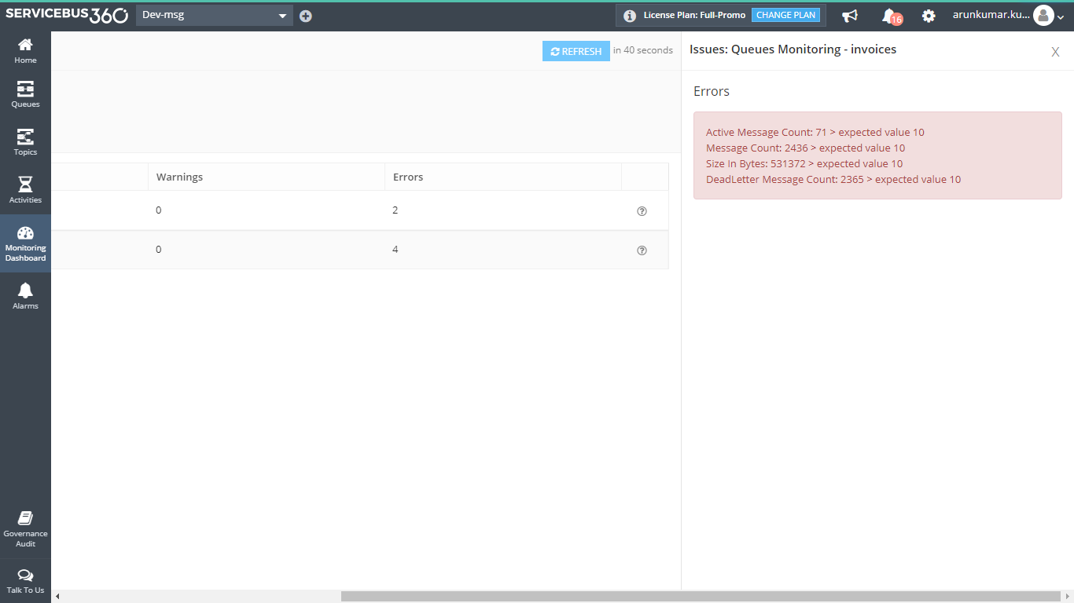
Monitor Entities
Is my Queue functioning properly?
Are the messages read properly?
Are there messages retained in the Queue for long time?
Can I receive an alert if something is not as expected?
If so, something is wrong with my downstream application..

Slide 31
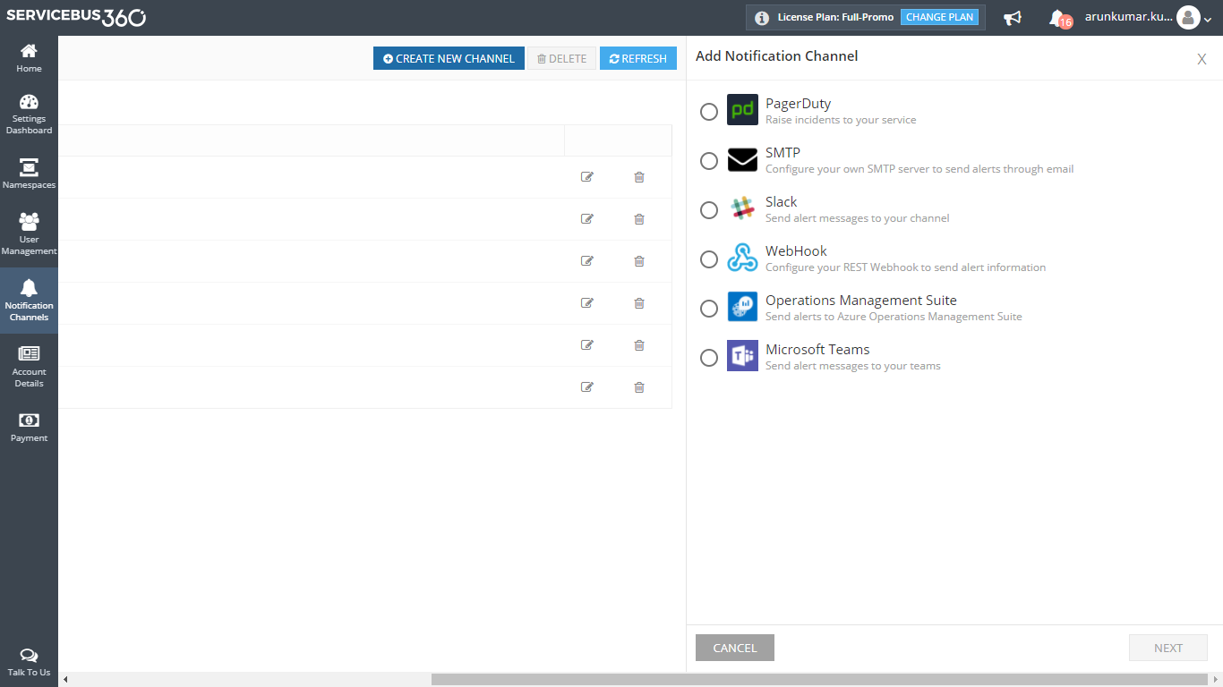
Receive Alerts to understand the state of your entities
What are the possible channels, I can receive alerts?
Channelize alerts to specific teams in your organisation

Slide 32
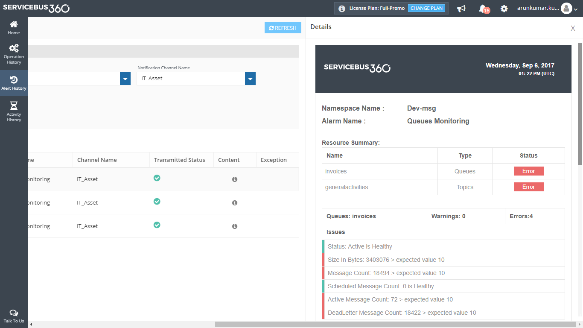
Receive Alerts to understand the state of your entities
What do I see in the alerts?
Can I receive categorized alerts?
Can I receive alerts for specific parameters?
Periodic status reports will help better to understand the health of entities

Slide 34
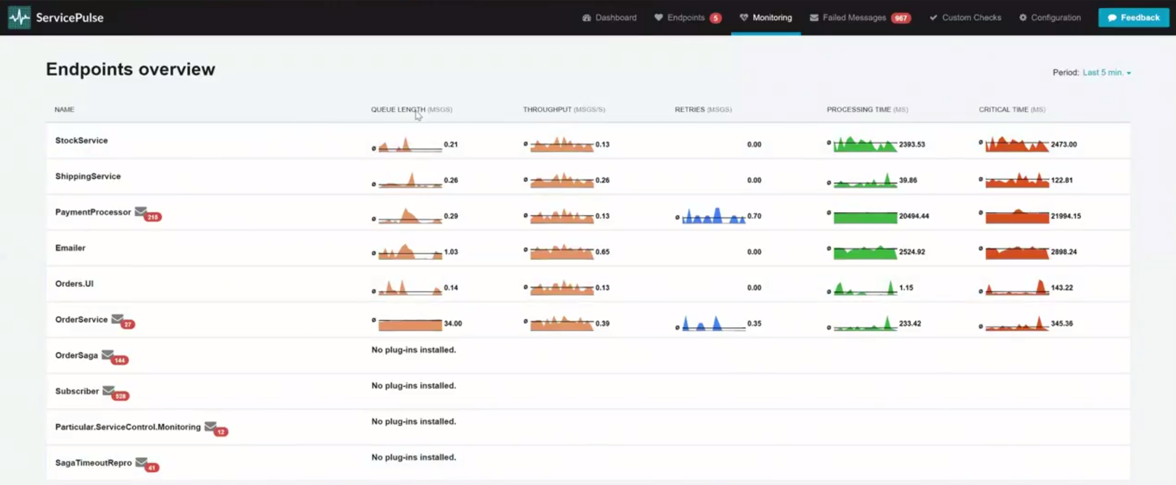
ServicePulse vNext (preview)
Notes:
Zoom into PaymentProcessor to explain how errors affect everything

Slide 35


